Slide 1
DISTRIBUTED SYSTEMS Principles and Paradigms Third Edition MAARTEN VAN STEEN ANDREW S. TANENBAUM Chapter 4 Communication

Slide 2
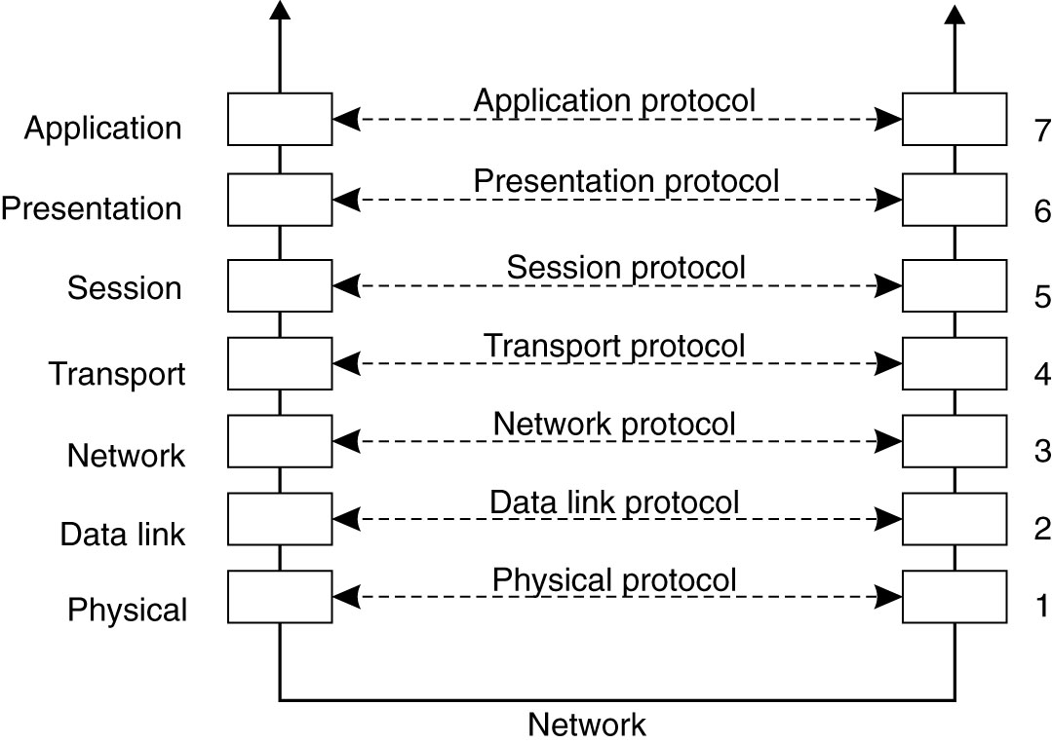
Layered Protocols
Figure 4-1. Layers, interfaces, and protocols in the OSI model.

Slide 3
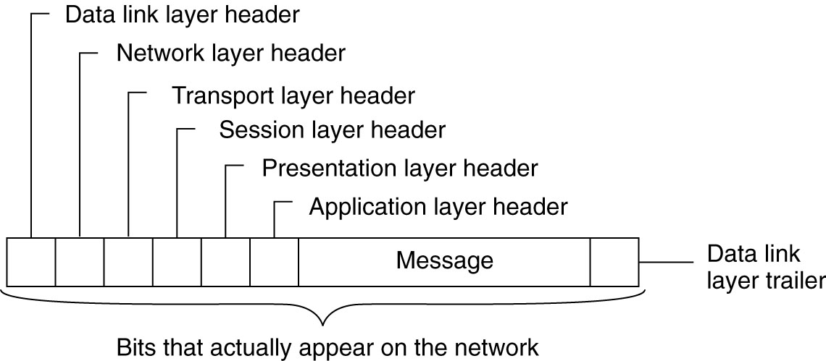
Figure 4-2. A typical message as it appears on the network.

Slide 4
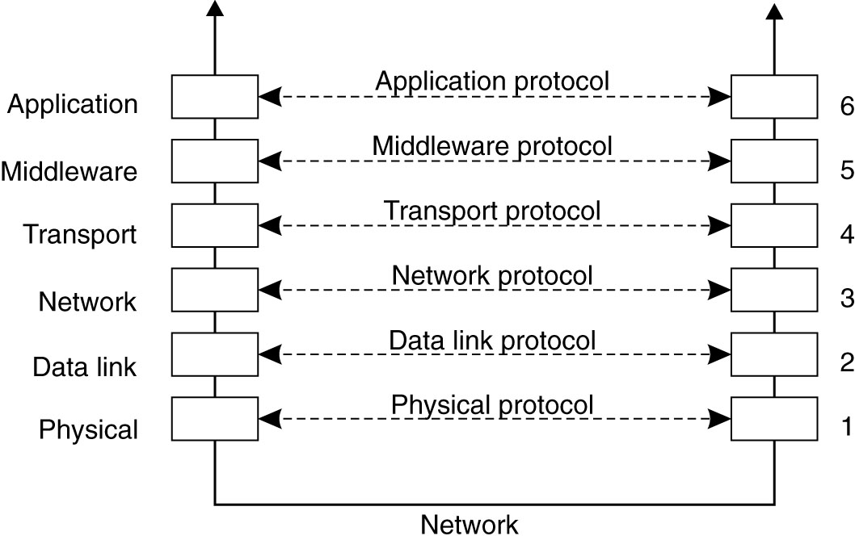
Middleware Protocols
Figure 4-3. An adapted reference model for networked communication.

Slide 5
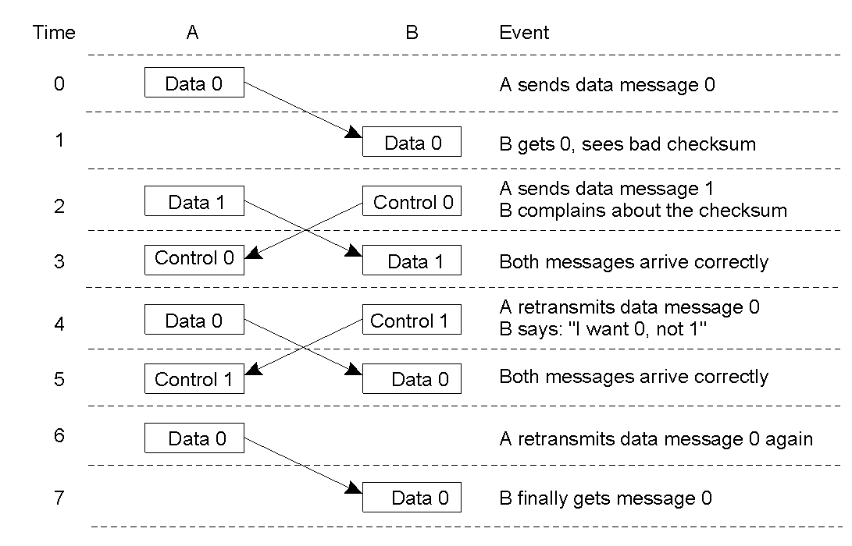
Data Link Layer (ed. 1)
2-3
Discussion between a receiver and a sender in the data link layer.

Slide 6
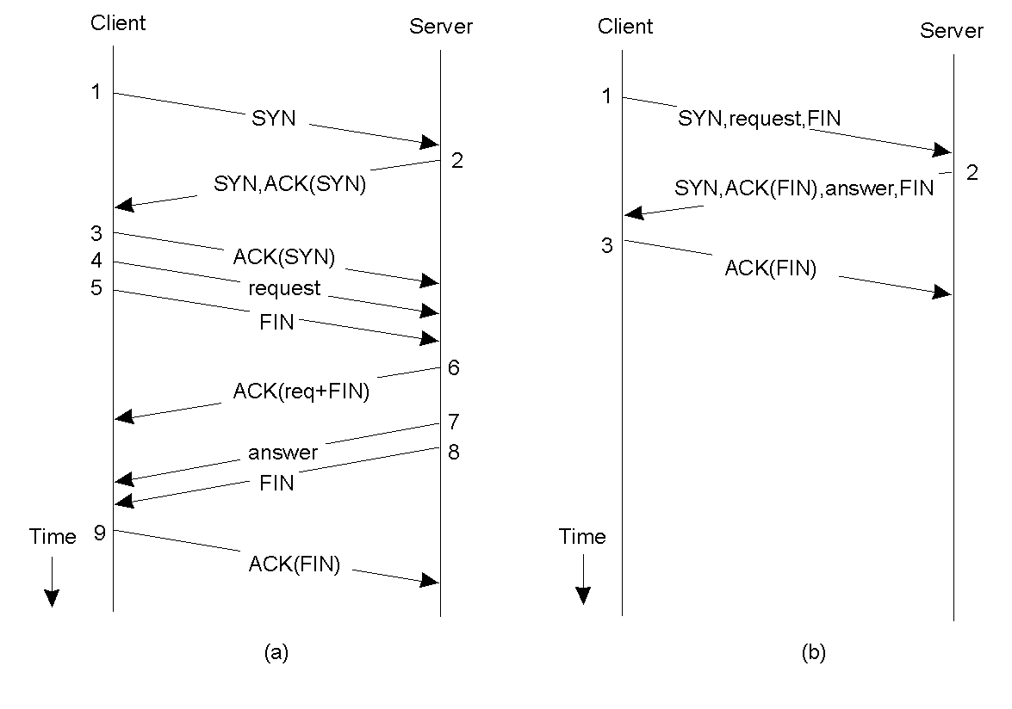
Client-Server TCP (ed. 1)
2-4
Normal operation of TCP.
Transactional TCP.

Slide 7
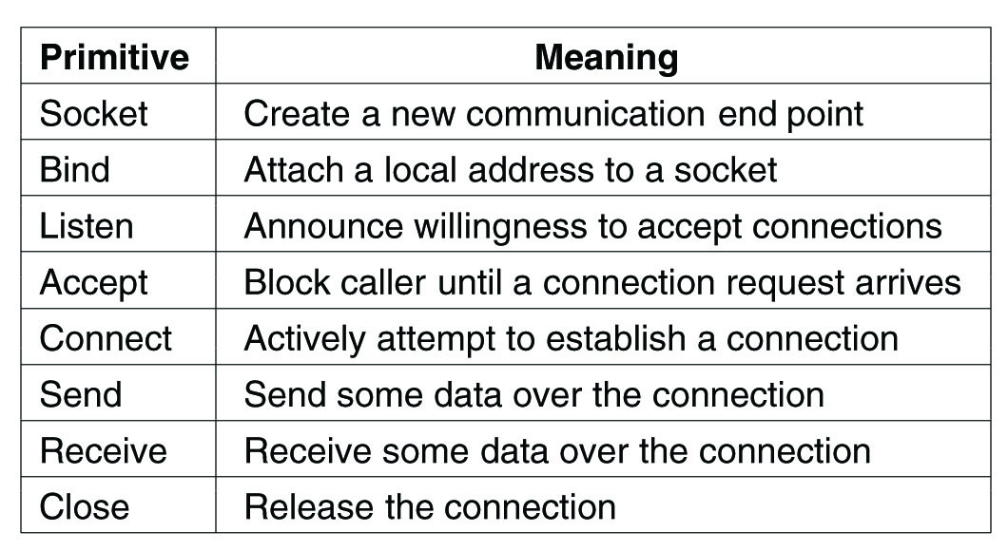
Berkeley Sockets
Figure 4-14. The socket primitives for TCP/IP.

Slide 8
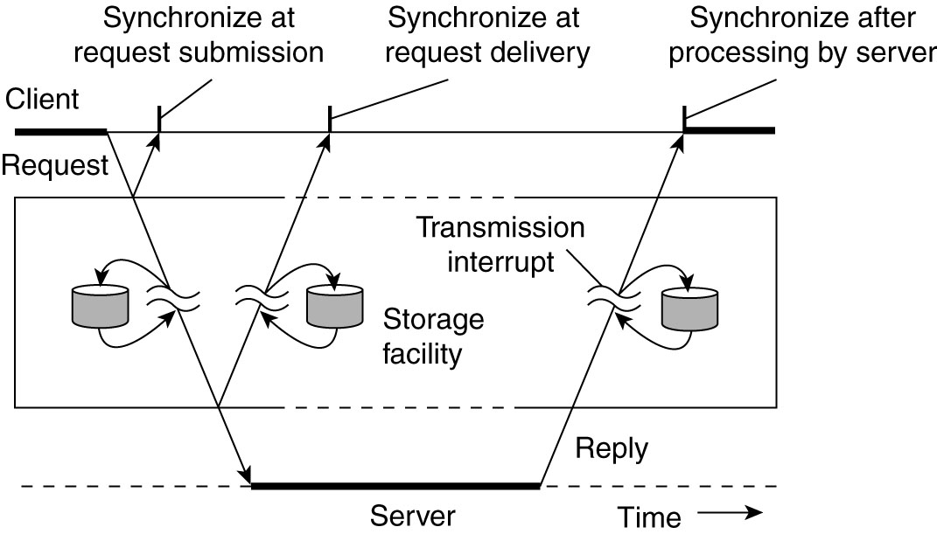
Types of Communication
Figure 4-4. Viewing middleware as an intermediate (distributed) service in application-level communication.

Slide 9
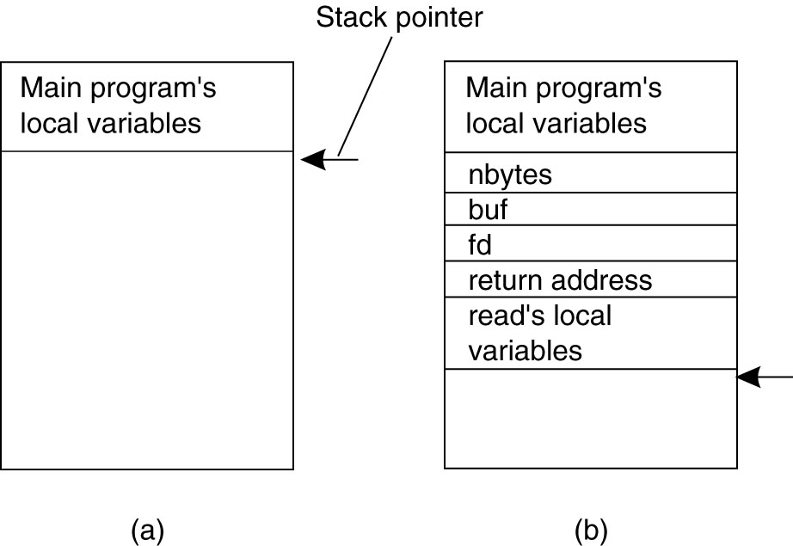
Conventional Procedure Call
Figure 4-5. (a) Parameter passing in a local procedure call: the stack before the call to read. (b) The stack while the called procedure is active.

Slide 10
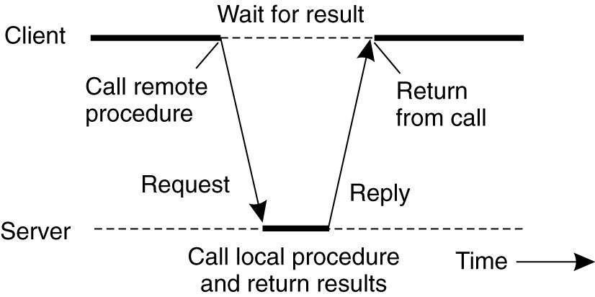
Client and Server Stubs
Figure 4-6. Principle of RPC between a client and server program.

Slide 11
Steps of a Remote Procedure Call
Client stub builds message, calls local OS
Client's OS sends message to remote OS
Remote OS gives message to server stub/skeleton
Server stub unpacks parameters, calls server
Server does work, returns result to the stub
Server stub packs it in message, calls local OS
Server's OS sends message to client's OS
Client's OS gives message to client stub
Stub unpacks result, returns to client

Slide 12
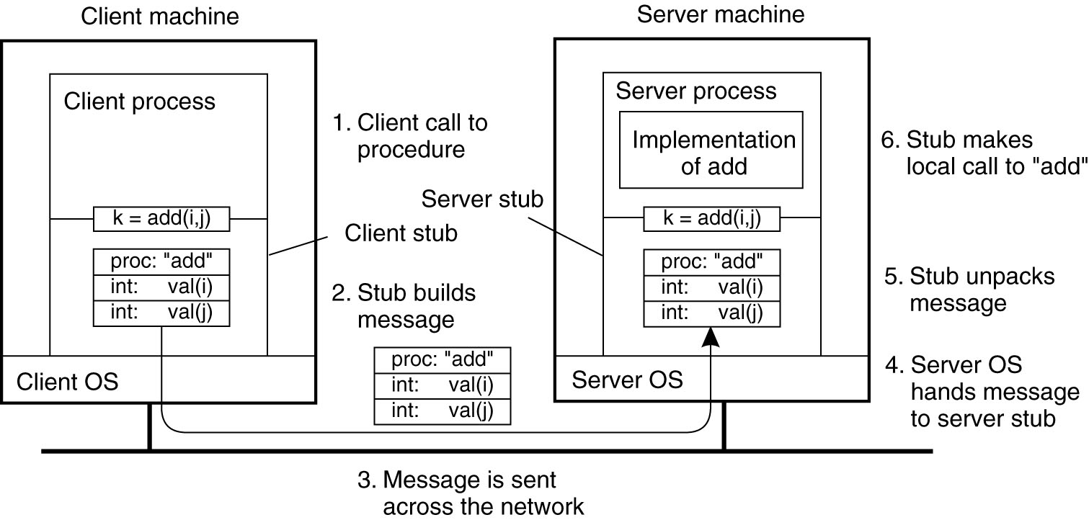
Passing Value Parameters (1)
Figure 4-7. The steps involved in a doing a remote computation through RPC.

Slide 13
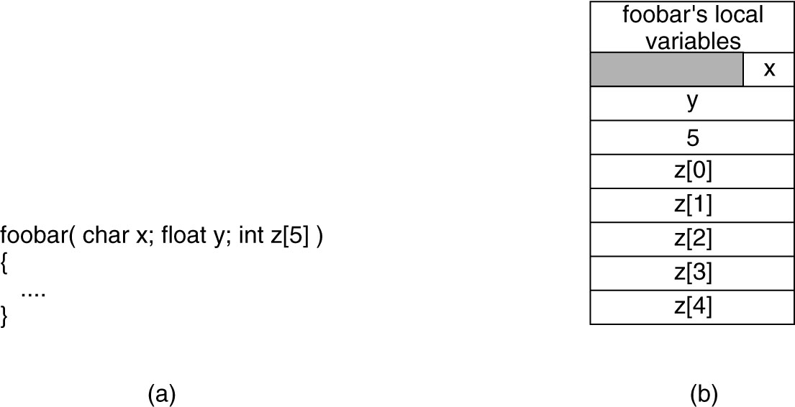
Parameter Specification and Stub Generation
Figure 4-9. (a) A procedure. (b) The corresponding message.

Slide 14
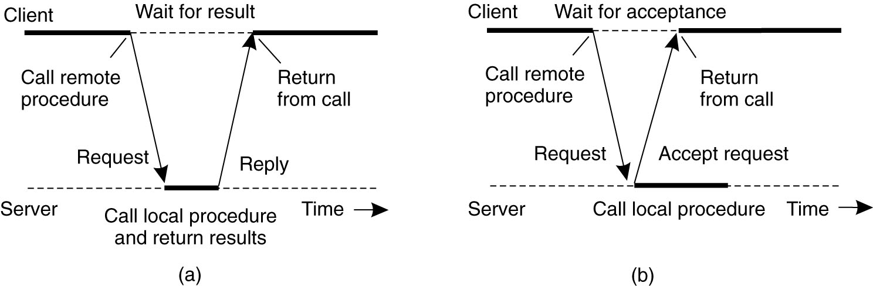
Synchronous RPC
Figure 4-10. (a) The interaction between client and server in a traditional RPC.

Slide 15
Asynchronous RPC
Figure 4-10. (b) The interaction using asynchronous RPC.

Slide 16
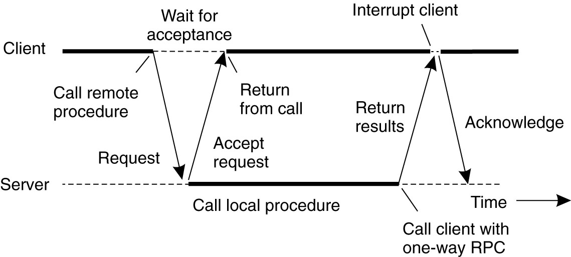
Figure 4-11. A client and server interacting through two asynchronous RPCs.

Slide 17
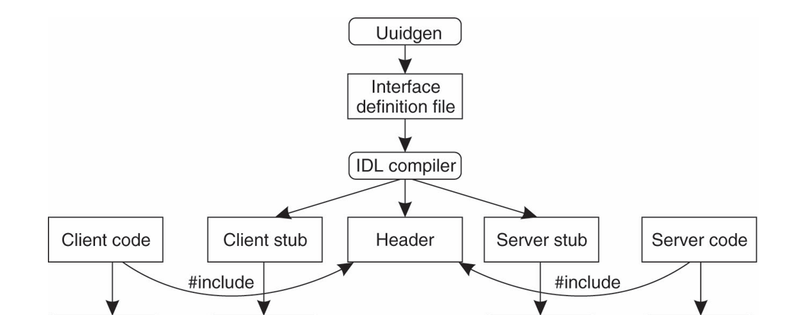
Writing a Client and a Server
Figure 4-12b. Using IDL compiler to generate client stub and server skeleton/stub

Slide 18
Three files produced by the IDL compiler
A header file with parameter data declarations in it.
The client stub shell code with input parameters and return values defined.
The server stub/skeleton with input parameters and return values defined.

Slide 19

Classic RPC
Add the general understanding of how classic RPC works to your toolbox.

Slide 20
Binding a DCE Client to a Server
Registration of a server makes it possible for a client to locate the server and bind to it.
Server location is done in two steps:
Locate the server’s machine.
Locate the server on that machine.

Slide 21
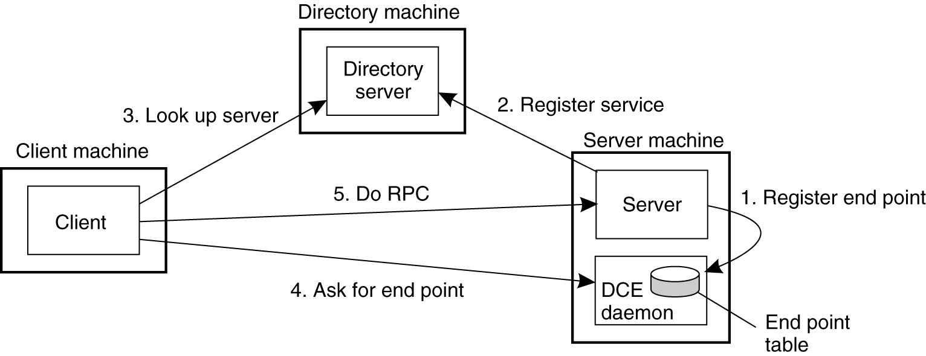
Figure 4-13. Client-to-server binding in DCE.

Slide 22
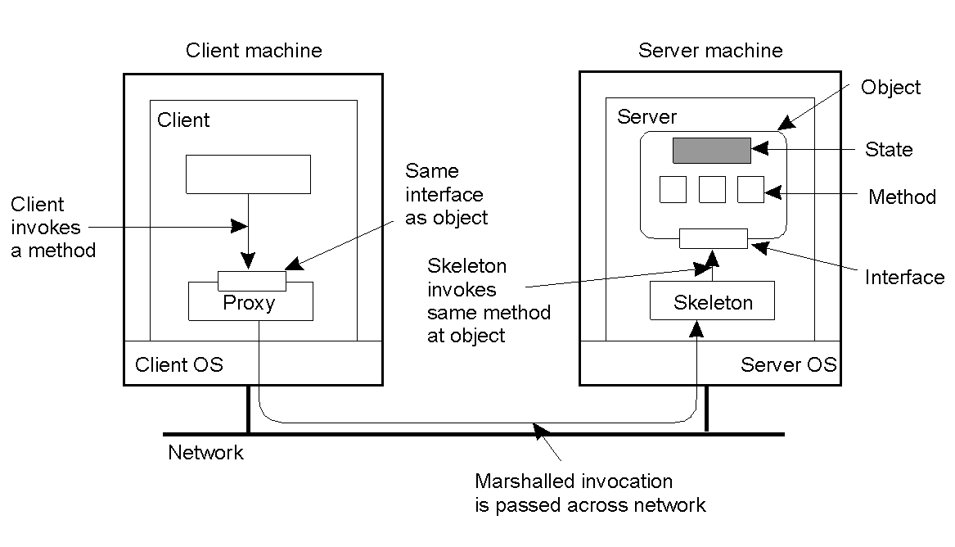
Distributed Objects
2-16
Common organization of a remote object with client-side proxy.

Slide 23
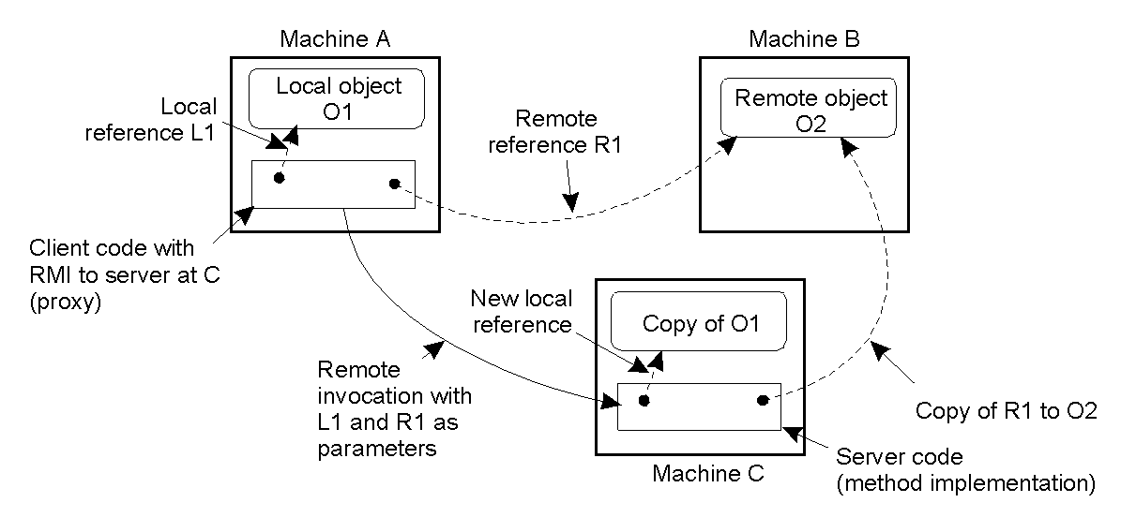
Parameter Passing
2-18
The situation when passing an object by reference or by value.

Slide 24
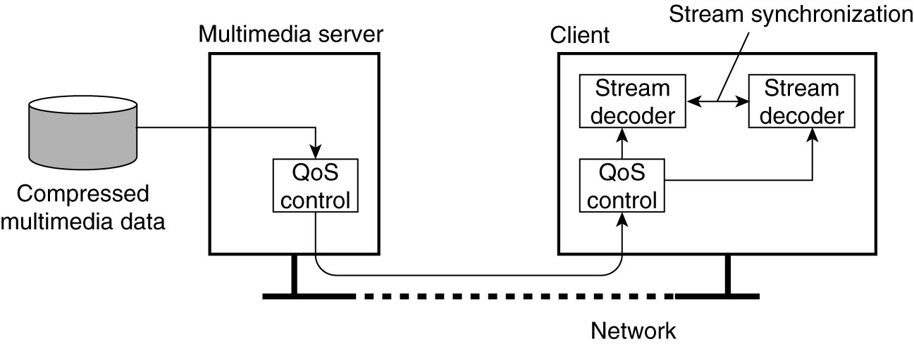
Data Stream
Figure 4-26. A general architecture for streaming stored multimedia data over a network.

Slide 25
Asynchronous Transmission Mode
The data items are sent one after the other in sequence.
No other timing constraints.

Slide 26
Synchronous Transmission Mode
Maximum end-to-end delay
No constraint on arriving early.
Example is sensor data that is aggregated at intervals—must arrive in time, but no penalty if it arrives early.

Slide 27
Isochronous Transmission Mode
Pronounced ai·saa·kruh·nuhs
Data units are transferred on time
Cannot arrive late, and cannot arrive early (buffer size limit!)
Early arrival can cause problems with buffer space.
Requires bounds on jitter—the variation in the transfer time between units.
Continuous data transfer using isochronous transfer mode is often simply referred to as streaming data

Slide 28
Properties of streaming data
Stored data streamed from files
Live data streamed from a real-time source
“Loop” delayed live streaming data
Compressed data—how much compression?
Secure data—how much overhead? authentication model at playback?

Slide 29
Audio timing is critical
When a video signal is degraded we an usually adapt reasonably well.
When the audio signal is degraded too much, and in particular degraded with digital artifacts, it is fatiguing and we lose important content cues at the cognitive level.
The visual landscape tends to be static and supported by static environmental cues.
The aural landscape is ephemeral—we have limited buffers in which to keep the signal alive in memory without environmental cues.

Slide 30
Sellon et al., 2019
“The tectorial membrane (TM) [in the ear] is widely believed to play a significant role in determining the remarkable frequency selectivity and sensitivity that are hallmarks of mammalian hearing by virtue of its resonance and traveling wave properties.”
[...] the molecular mechanism underlying the mechanical properties of the TM depends on both the elastic properties of the matrix and the viscous properties of the interstitial fluids. Fluid flow through the nanoporous structure of the TM can directly affect the nanometer-scale motions of the hair bundles. Such fluid flow through the matrix and the separation of fluid flow and matrix movements can be directly measured at the nanoscale.

Slide 31
The nanoscale is the dimensional range of approximately 1 to 100 nanometres.
nanometer = one billionth of a meter.
X-ray/Ultraviolet = 10 nm 3 × 10¹⁶ Hz
Our ears partially operate at sensitivity levels near X-ray frequencies. (Used to emphasize selectivity of frequency ranges.)

Slide 32
MIT Reference 2019
Nanoscale Poroelasticity of the Tectorial Membrane Determines Hair Bundle Deflections
Jonathan B. Sellon, Mojtaba Azadi, Ramin Oftadeh, Hadi Tavakoli Nia, Roozbeh Ghaffari, Alan J. Grodzinsky, and Dennis M. Freeman
Phys. Rev. Lett. 122, 028101 – Published 16 January 2019

Slide 33
3D spatial imagery in sound
Humans are very sensitive to audio imaging. Less so to visual imagery which tends to be more stable. Audio input is translated into 3D cognitive imagery in the brain.
Where is that saber-toothed tiger I heard outside the cave?
Many humans are highly sensitive to audio degradations and find analog sound (e.g. LPs) to be highly superior to digitized sound, even at $600K digital reproduction level.
To maintain a good cognitive information signal we must do a minimally good job of reproducing the sound in streaming data.

Slide 34
External clocks for high-quality digital recordings and reproduction can cost tens of thousands of dollars, working at billionths of a second.
Audio imaging is also highly sensitive to timing issues, affecting meaning in the sound.
The difference between a $30,000 CD player and a $100 player usually is jitter. A standard CPU clock, running at billionths of a second might cost… 30 cents?
https://us.auralic.com/products/leo-gx?variant=30278570836004 Master clock $8300.

Slide 35
Multi-channel sound
When multiple channels of sound are delivered, damage to any of the individual signals, and errors in the timing of the simultaneous delivery (synchronization) of the audio channels can greatly reduce the spatial imagery contained in the signal.
This affects the cognitive content in the sound.
Where in 3D space is that saber-toothed tiger I heard outside the cave? Is it aware I am here? (Motion within the 3D space.)

Slide 36
Modern media sound
Up to 10.1 channels of sound
All must be carefully synchronized.
Clock timing, jitter, and synchronization are all crucial to good sound.
Sound can degrade in many ways:
Hard to understand spoken dialogue (often much worse than analogue)
Harsh sounding, or unpleasant, without quite realizing it. Affects body state.
Fatiguing to listen for long periods.

Slide 37
Digitized sound delivery
Add to your toolbox a general understanding of why special care must be taken with the delivery of aural signals in a distributed system.

Slide 38
Many channels
Many surround sound channels
Video
Picture-in-picture track for commentary
Multiple subtitles
Alternate audio for director commentary, actor commentary, different languages…

Slide 39
Two main approaches to synchronization
Multiple streaming channels.
Multiplexing.

Slide 40
Multiple streaming channels
Embed synchronization flags into each channel at regular intervals and use these to line all the channels up at playback time.
Easy to implement: just open a separate socket connection for each channel. Trivial real-time reproduction at the remote site with no intermediate storage in memory.
Requires “dropping” part of a packet at regular intervals and substituting synchronization data.
Can be used live or with stored data.
Complicated at the restoration end. Non-trivial synchronization.

Slide 41
Multiplexing
Multiplex ALL of the channels together so that each piece of data that occurs at any moment in time gets placed in the same packet of data as all other pieces of data occurring at that same time.
Allows very good, and entirely methodical synchronization. Cannot get out of sync.
Requires overhead at each end in the QoS code to multiplex and de-multiplex the data.
What happens when you add channels?

Slide 42
Multi-channel delivery in distributed systems
Add to your toolbox a general understanding of the tradeoffs between using multiple independent streams and multiplexing the streams together into a single channel.

Slide 43
Network level support – DiffServ on IP
Differentiated services, 6 bit header
Classify and mark packets by up to 64 (2⁶⁾ categories. But typical is 4:
Default per-hop behavior (PHB): Best effort, depends on current circumstances
Expedited forwarding: Low loss, low delay, low jitter, no more than 30% total traffic
Voice Admit: EF, but limits number to avoid conflicts
Assured forwarding: assured up to a saturation level, then not

Slide 44
Streams and Quality of Service
Properties for Quality of Service:
The required bit rate at which data should be transported.
The maximum delay until a session has been set up
The maximum end-to-end delay.
The maximum delay variance, or jitter.
The maximum round-trip delay.

Slide 45
Best general answer to QoS questions:
You fell asleep for a minute after cramming all night for a critical interview for a much-desired position.
You know the question is about Quality of Service, but you missed the details. Which answer should you give?
“Yes sir! We probably want bigger buffers…” ☺

Slide 46
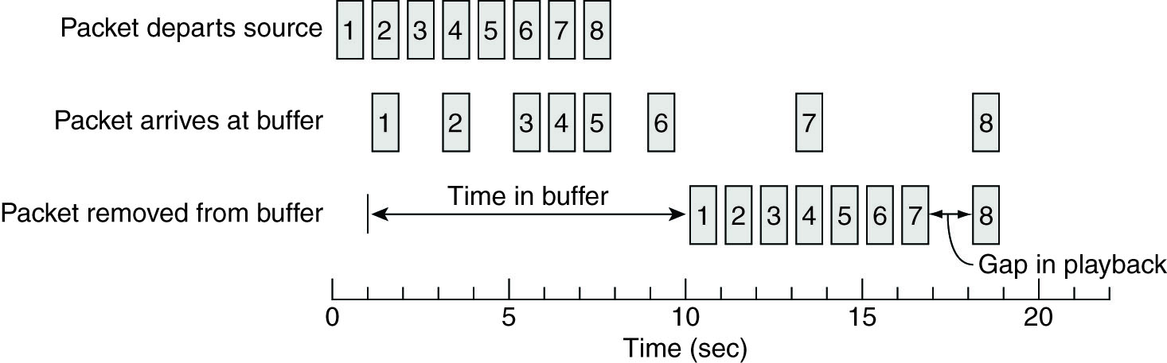
Enforcing QoS (1)
Figure 4-27. Using a buffer to reduce jitter.

Slide 47
Bigger Buffer….
To reduce jitter:
Constant average delivery is timely
The bigger the buffer, the better extremes are handled.
More delay in startup to fill the buffer part way.
Always a tradeoff, and prediction is important: E.g.—how much do you fill the buffer at startup?

Slide 48
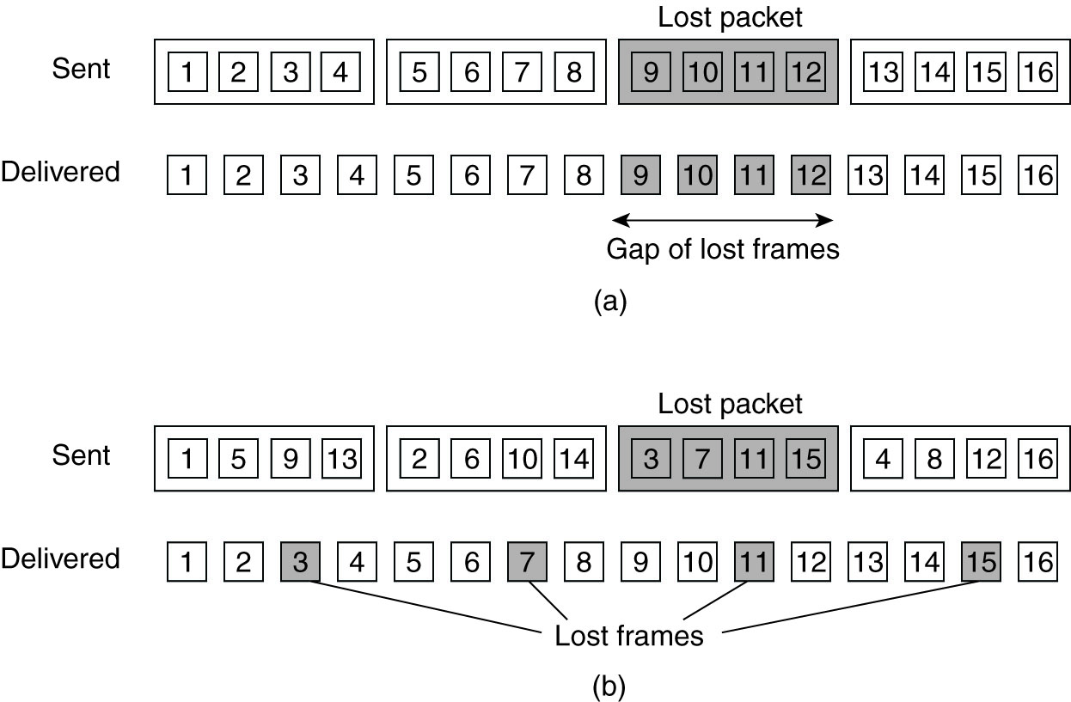
Enforcing QoS (2)
Figure 4-28. The effect of packet loss in (a) non interleaved transmission and (b) interleaved transmission.

Slide 49
QoS Expertise in your toolbox…
Best general answer to questions about Quality of Service: bigger buffers.
Using a receive buffer to reduce jitter.
Using send and receive buffers to implement interleaving of packets to reduce the impact of network burst errors.

Slide 50
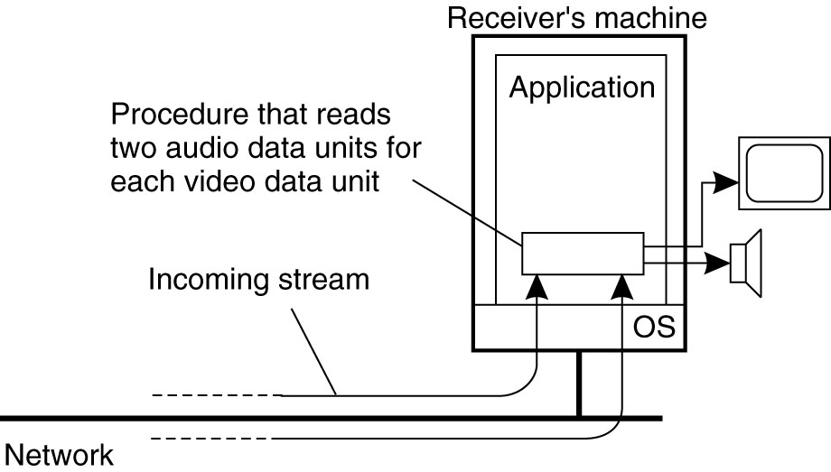
Synchronization Mechanisms (1)
Figure 4-29. The principle of explicit synchronization on the level data units.

Slide 51
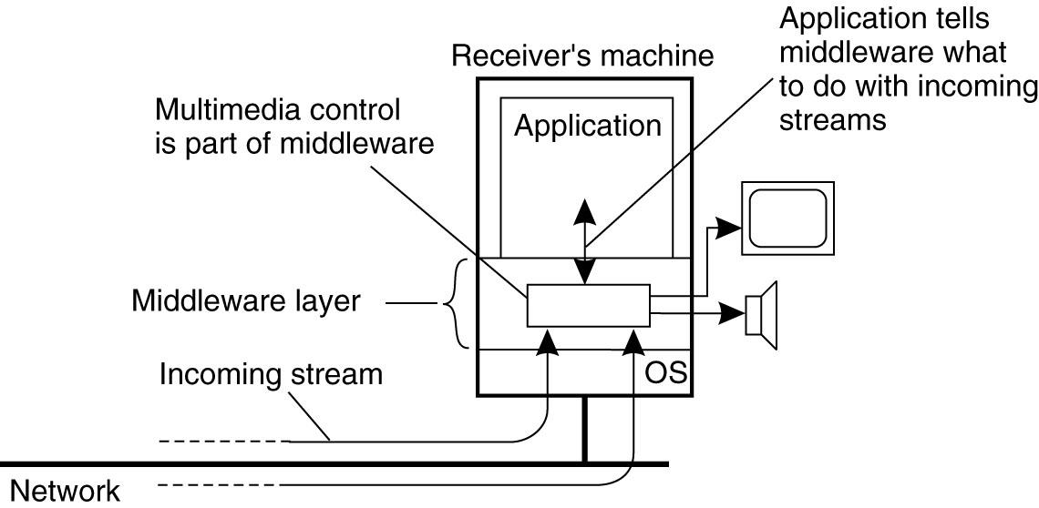
Synchronization Mechanisms (2)
Figure 4-30. The principle of synchronization as supported by high-level interfaces.

Slide 52
Multiplexing
As syncronization gets more complex, there is more need for real-time distribution of synchronization specifications
Multiplex all the data streams into one, and send the sync info too.
Motion Picture Experts Group (MPEG) standards.
Can perform sync at sender if multiplexed, when receiver decodes, is already sync’d.

Slide 53
Multiplexing
Add the central ideas of Quality of Service, Multiplexing, and the understanding of how bigger buffers are often going to come into play to your toolbox.

Slide 54
Case study—multicast using a DHT

Slide 55
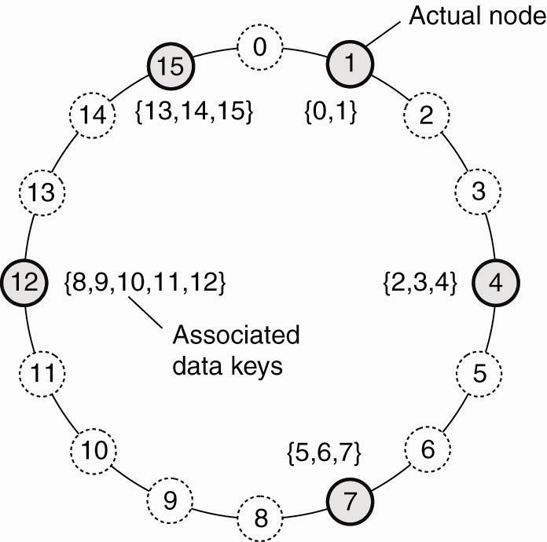
Uses a Structured Peer-to-Peer Architecture
Figure 2-7. The mapping of data items onto nodes in Chord.

Slide 56
Application-level Multicast
Can cross router and network boundaries
May not be as efficient as network-level multicast
Must construct an overlay-network
Organized as a tree – one path to each node
…or as a mesh-network – multiple paths between pairs of nodes. This is more robust when a node fails – alternate paths.

Slide 57
Building a multicast tree with the DHT
Any DHT node can accept Mcast commands
Nodes can come and go from the DHT at will
Nodes can join up with and drop from the Mcast group at will.
Mcast nodes can be DHT members, or linked from DHT members.

Slide 58
Mcast Operations
Create(M_ID)—create the multicast group
Join (M_ID, node)—a processing node joins the mcast group
Leave (M_ID, node)—a node leaves the mcast group
Mcast(M_ID, msg)—a message is sent to the mcast group
Destroy(M_ID)—destroy the multicast group

Slide 59
Generate Multicast ID M, a random value (140 bits?)—this is the NAME of the multicast group. M is handled by the appropriate DHT node.
Send build msg DHT(M) to any DHT node, this gets passed along to the right DHT node which becomes the root of the multicast group where messages are processed, archived, forwarded to the group, etc.

Slide 60
To join an Mcast group, any node marks itself as being a member of the group for M then, if it is not a DHT node, it passes the request to a DHT node.
Any DHT node can accept a request (including from itself) to join an Mcast group, which is passed up to the Mcast root for M.

Slide 61
If an intermediary DHT node has not seen a request before, it becomes the parent of the new node in the multicast tree. It marks itself as a forwarder.
Then it forwards a request, along the DHT path toward the root. Forwarders also need parents. (It can, itself, join the group later by simply changing it’s own status from forwarder to member.)

Slide 62
If the DHT node has already seen a request for any node to join the multicast group M, it adds the previous node as its own child, and does not forward the request up toward the root (because it has done so previously).

Slide 63
Nodes wishing to join the multicast group are theoretically independent of the DHT. In this way, a DHT node may have many Mcast children for the group M, one of which might be in the DHT

Slide 64
Three types of DHT nodes:
Not (yet) participating
Pure forwarders
Forwarder-members

Slide 65
Sending Multicast messages
M_Cast(M, message)
These are passed up to the root for the Mcast group identified by M
The root then processes the request (censors / archives / etc.) and then issues the multicast.
M_Cast group members get the messages, forwarders and members forward them.

Slide 66
To change from forwarder to member is easy. Just flip a bit.
To change from member to forwarder is easy. Just flip the bit back.

Slide 67
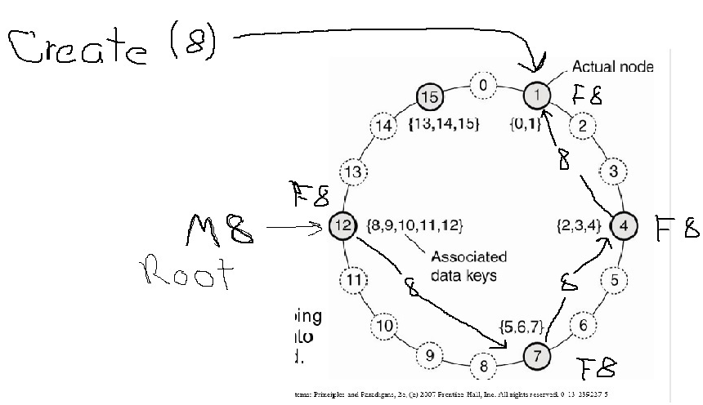

Slide 68
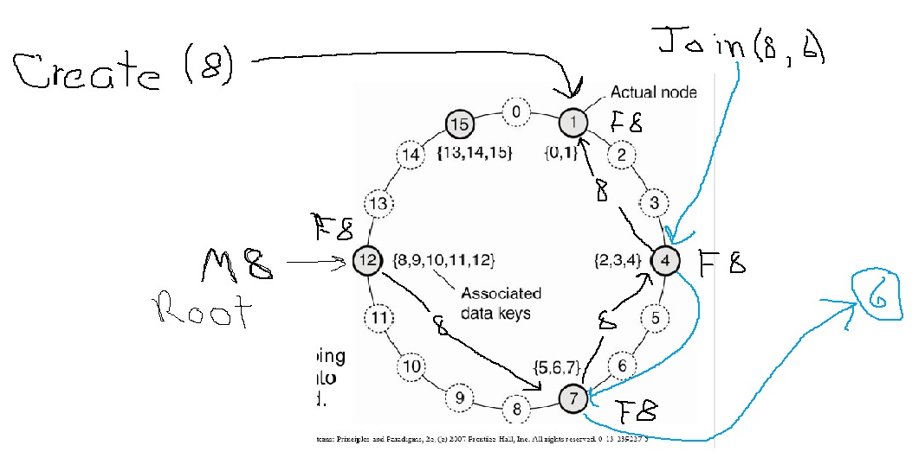

Slide 69
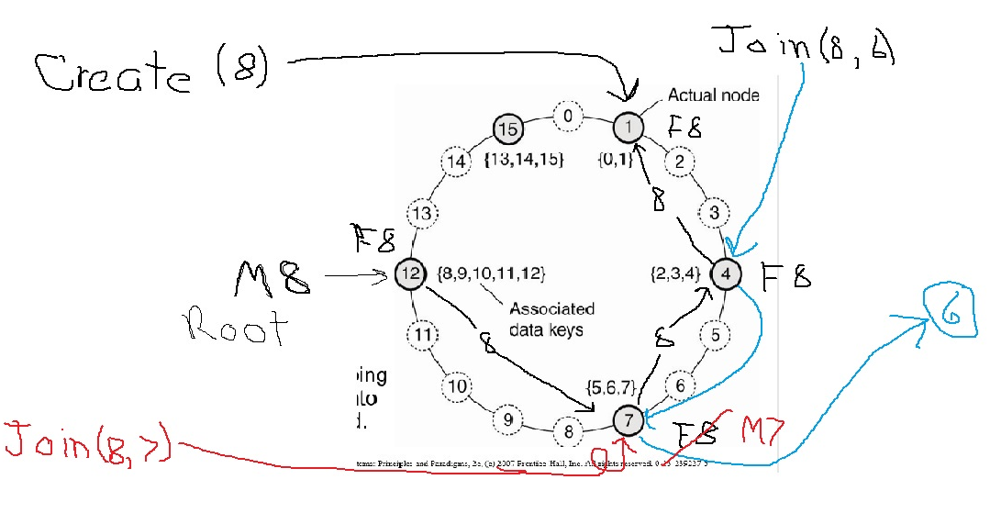

Slide 70
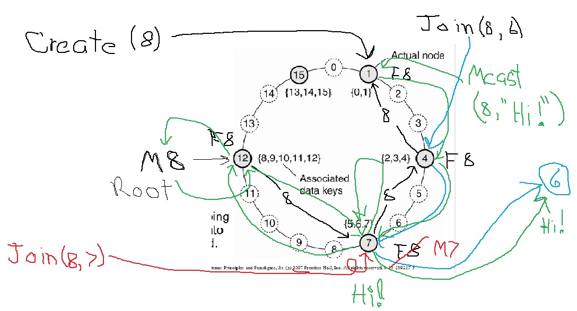

Slide 71
Multiple groups
A DHT can support as many Mcast groups as there are ID numbers in the DHT hash universe. Each Mcast group is distinct. E.g., a four-bit hash identifier for the DHT allows for 16 Mcast groups.
To add another Mcast group, the procedure is the same. Each DHT keeps an array or list of forwarding pointers, with one element for each Mcast group

Slide 72
Flexibility
Nodes can leave the Mcast group at will: DHT members become forwarders. External nodes are dropped as children, or else stay as children but stop receiving messages, if they will join again later.
Nodes can join and leave the DHT in the usual way by splitting and combining Mcast responsibilities, moving them as necessary.

Slide 73
DHT case study: Application-level Multicast
Add the design of an application-level multicast system using a Distributed Hash Table to your toolbox.
Do you understand how DHT’s can be useful and flexible?

Slide 74
Overlay networks
In many of the examples this quarter we consider networks at the application level (e.g. token-ring, DHT). These are logical networks which are implemented one level up from the physical network.
In the following slide, there is a logical path from Node B to Node D but this is implemented via the intermediary physical path from Node A to Node C.
A packet that is multicast from Node A (A to B, A to C, B to D) might end up being sent twice over the physical path from A to C.

Slide 75
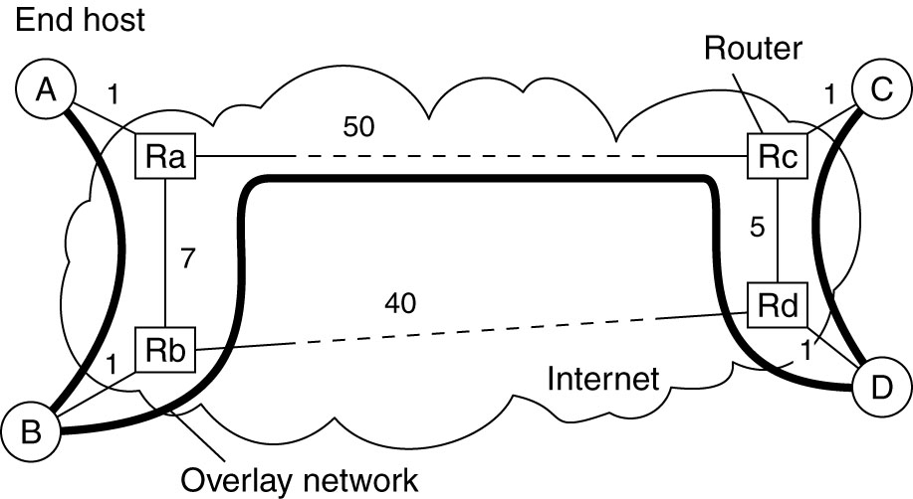
Overlay Construction
Figure 4-31. The relation between links in an overlay and actual network-level routes.

Slide 76
Overlay networks
Add the concept of a logical overlay network to your toolbox.
Overlay networks separate the concept of our network within the context of an application from the physical implementation of it.

Slide 77
Gossip-based dissemination—Epidemic protocols
Simple algorithm
Robust
Needs only local information
A simplifying assumption is that sending is initiated by a single node, thus avoiding multiple-write problems.
Nodes are infected (Seen the msg), or susceptible (have not seen the msg).
A node is removed if not willing to infect others.

Slide 78
Information Dissemination Models
Anti-entropy propagation model
Node P picks another nearby node Q at random
Subsequently exchanges updates with Q

Slide 79
Approaches to exchanging updates
P only pushes its own updates to Q
P only pulls in new updates from Q
P and Q send updates to each other

Slide 80
Compromises example: Push-only
A pushes its own update to P:
A-> B, C, D, E, F
D-> G, H, I, J
J-> K, L, M, N, O, P
How long to infect from A to P?
Simple, but bad choice for rapid updates.
Only infected nodes can propagate
Probability of selecting an already infected node increases as the message spreads.

Slide 81
Pull only
P only pulls a new update from Q
Works better when many are already infected
Triggered by susceptible nodes, works better to spread to the message when fewer nodes are susceptible

Slide 82
Push-pull
Works best overall, though the others will work as well, and are simpler.
Depends on speed of spread requirements and efficiency needs
O(log(N)) “rounds” where a round is all nodes have chosen to exchange updates with some node, and N is number of nodes. So scales up well. But, is more complex.

Slide 83
Gossiping / rumor spreading
Keep telling the “hot news” until it appears that some number [“k”] of nodes have already heard the news, then get tired and give up. Approximate this with 1/k probability of giving up.

Slide 84
Gossiping / rumor spreading
Sometimes pure gossiping will leave some fraction of the nodes still not infected. Why keep gossiping if everyone you call already knows the gossip?
Combining gossip with anti-entropy can solve this problem.
The interaction between processes in gossip-based dissemination is small, so it tends to scale well.
Directional gossiping favors nodes with fewer network connections, considering them bridges to other parts of the graph.

Slide 85
Removing data in epidemics
The problem is that if all traces of the data have been removed, then later-arriving echoes of updates may unwittingly restore it.
Spread death-certificates instead. These mark data as deleted.
May wish to expire the death-certificates for cleanup.
Some nodes keep old certificates around so that if there is a late-arriving update, the death-certificate can be re-broadcast

Slide 86
Calculate the average value of the network using an epidemic
Imagine a network with 40,000 nodes in it storing some value X. Nodes come and go. You would like to know the average of the value X.
Imagine the nightmare of maintaining a root node to query all the values, then divide by the number of nodes. Very hard!

Slide 87
Epidemic gossiping algorithm to the rescue…
NODE:
Value of X
Temporary value of average X being calculated.
For nodes j and i that trade values X then set X-i and X-j to be the value (X-i + X-j) / 2. [The average – just store this somewhere, this is the new value for X for the purpose of the calculation]
Over time all the nodes will have the average stored locally, and something close to it as time progresses

Slide 88
Look at any node to see the currently calculated average of the values X stored in the network nodes.
Has the property that if you are in a hurry you’ll get an approximation, and the longer you can wait the more accurate the average will be.

Slide 89
Calculate the size of the network using an epidemic
Some node q sets its X-q = 1.
All other nodes n set their X-n = 0.
For nodes j and i that trade values X then set X-i and X-j to be the value (X-i + X-j) / 2. [The average – just store this somewhere, this is the new value for X for the purpose of the calculation]
Over time all the nodes n will have a value from which they can calculate the size of the network as 1 / X-n.

Slide 90
Epidemic protocols and gossip-based dissemination
Add the design of epidemic protocols to your toolbox.
Add the two specific algorithms for calculating the average value stored in a large ad-hoc network and its size using an epidemic protocol.

Slide 91
.

Slide 93
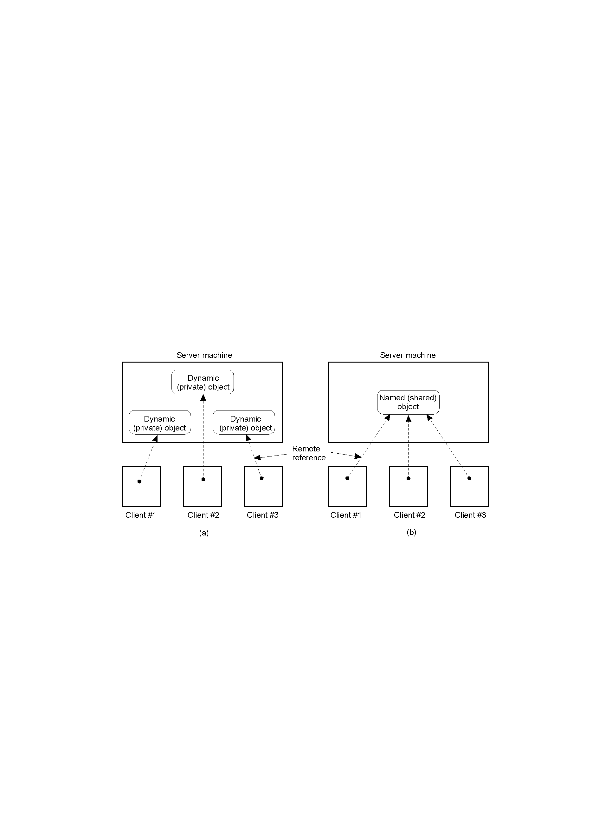
The DCE Distributed-Object Model
2-19
Distributed dynamic objects in DCE.
Distributed named objects

Slide 94
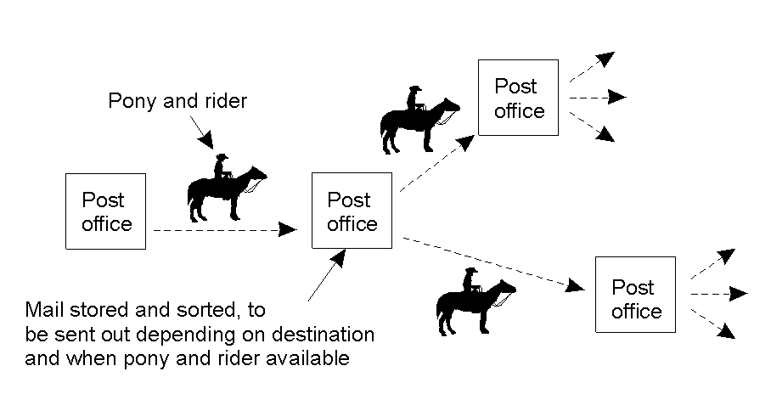
Persistence and Synchronicity in Communication (2)
Persistent communication of letters back in the days of the Pony Express.

Slide 95
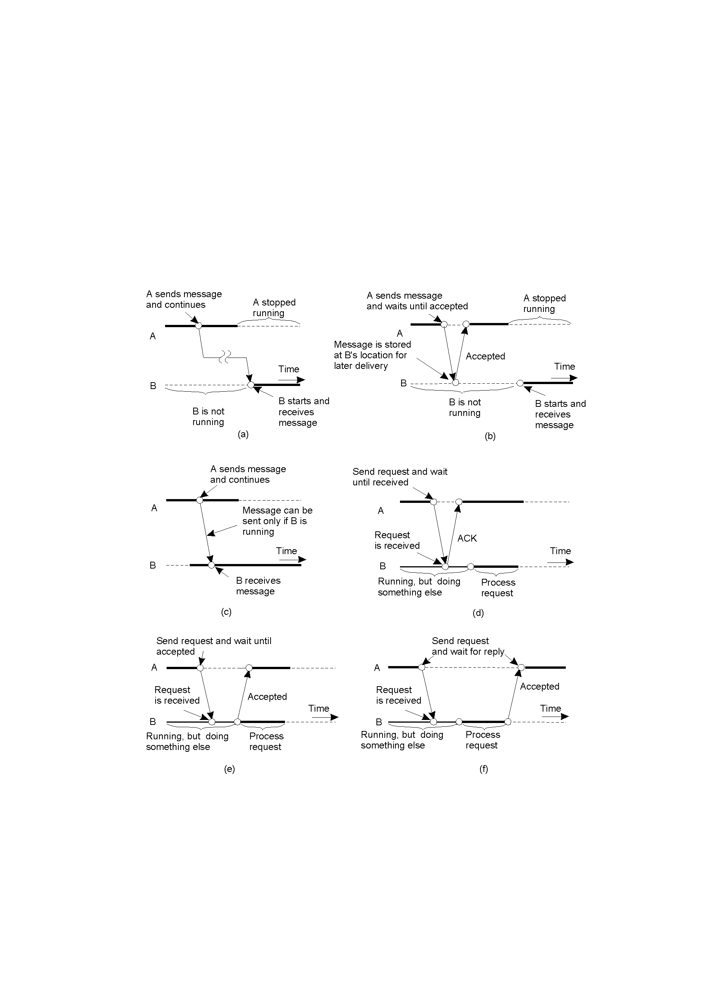
Persistence and Synchronicity in Communication (3)
2-22.1
Persistent asynchronous communication
Persistent synchronous communication

Slide 96
Persistence and Synchronicity in Communication (4)
2-22.2
Transient asynchronous communication
Receipt-based transient synchronous communication

Slide 97
Persistence and Synchronicity in Communication (5)
Delivery-based transient synchronous communication at message delivery
Response-based transient synchronous communication

Slide 98
Complex vs. Simple Streams
Simple:
Sequenced data, homogenous
Complex
Two or more substreams that are related.
Stereo signal – two independent streams, but must be synchronized
Movies – Video image, up to six channels of audio (or more), subtitles in different languages, etc.

Slide 99
Continuous vs. discrete
Properties for Quality of Service:
Discrete, static media:
Text, still images, executables, objects
How to degrade signal? E.g. compromise between delay, or loss of some data?
Continuous media: sound files, movie files.
Temporal relationship is fundamental
How to degrade the signal? E.g., compromise between delay, or poor quality?

Slide 100
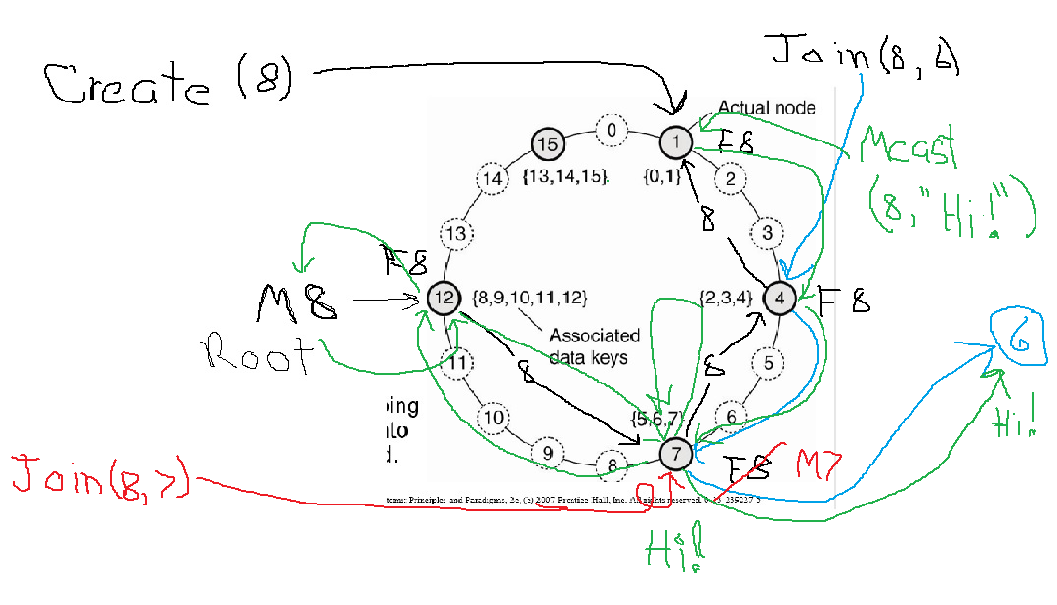

Slide 101
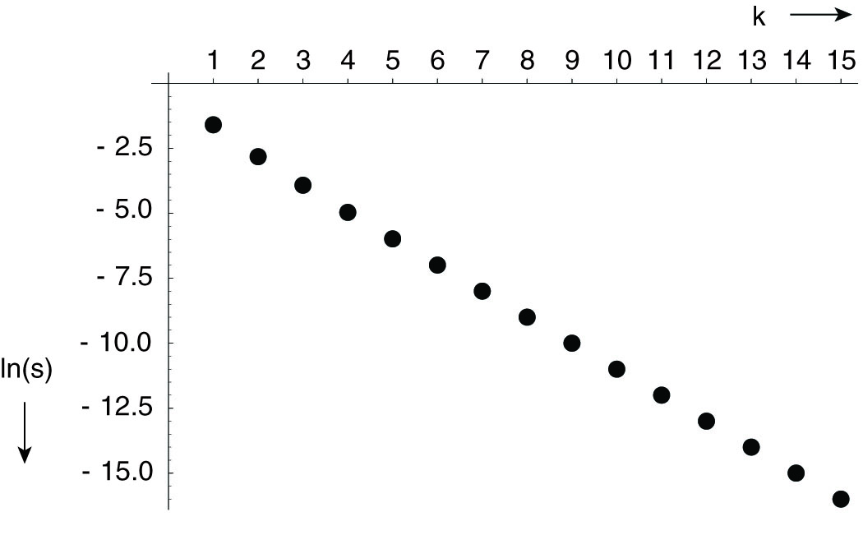
Information Dissemination Models (2)
Figure 4-32. The relation between the fraction s of update-ignorant nodes and the parameter k in pure gossiping. The graph displays ln(s) as a function of k.

